Slide 1

Exploratory Data Analysis
G2M INSIGHT FOR CAB INVESTMENT
Nov-18-2023

Slide 2

Agenda
Executive Summary
Problem Statement
Approach
EDA with Summary
Recommendations

Slide 3

Executive Summary
Our XYZ Company is planning to invest in Cab sector considering a remarkable growth and a strong positive forecast of Cab Industry in the recent years.
Analysis has been performed in line with the Go-to-Market(G2M) strategy of the company to comprehensively understand the market conditions to take a better final decision

Slide 4

Problem Statement
Problem Statement:
Assess, strategize and conclude the best cab company for investment among leading market cab players i.e., Yellow Cab and Pink Cab so that the company earns substantial profits and make the investment worth while

Slide 5
Approach
Our approach to addressing our problem statement can be divided into the following ways
Data Analysis and Master Data Generation
Profit, customer, Age, Holiday, Cities and Income based Investigation of insights through EDA
Summarizing EDA Results
Concluding on the Evidences and Recommendation

Slide 6
Data Analysis
The following Data is used for this approach – Cab, Customer, Transactions, City and Holiday
The timeline of the datasets is from 31-01-2016 to 31-12-2018
All the datasets are consolidated into a master data after necessary pre-processing like deleting duplicates, correcting data types, etc.
The Final master data contains 18 columns including 3 new columns generated after applying transformations from original columns

Slide 7
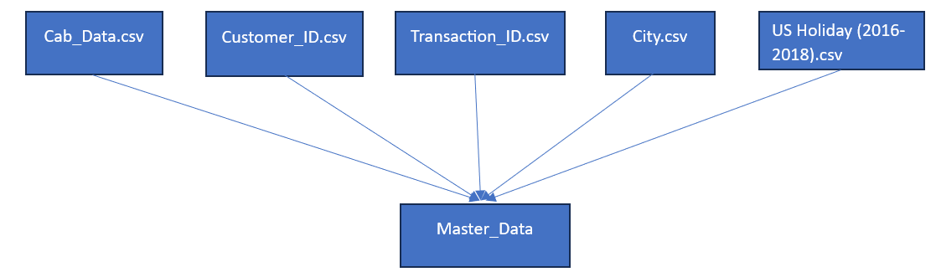
Master Data Generation
All the data is proven factual without any fake information
There are no outliers, duplicates or NA values in the Master Data
Data is combined based on viable join conditions

Slide 8
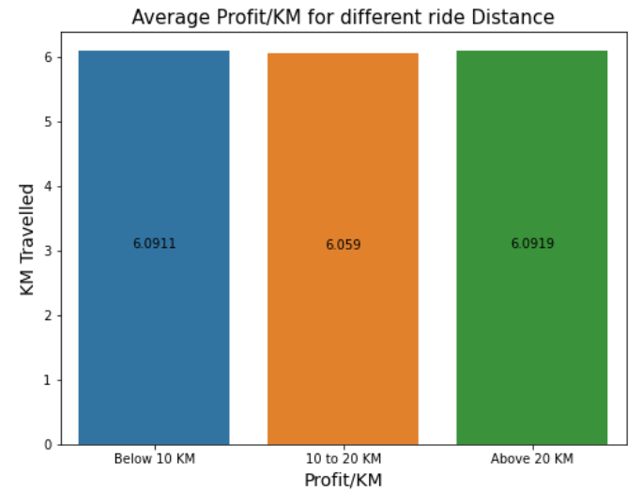
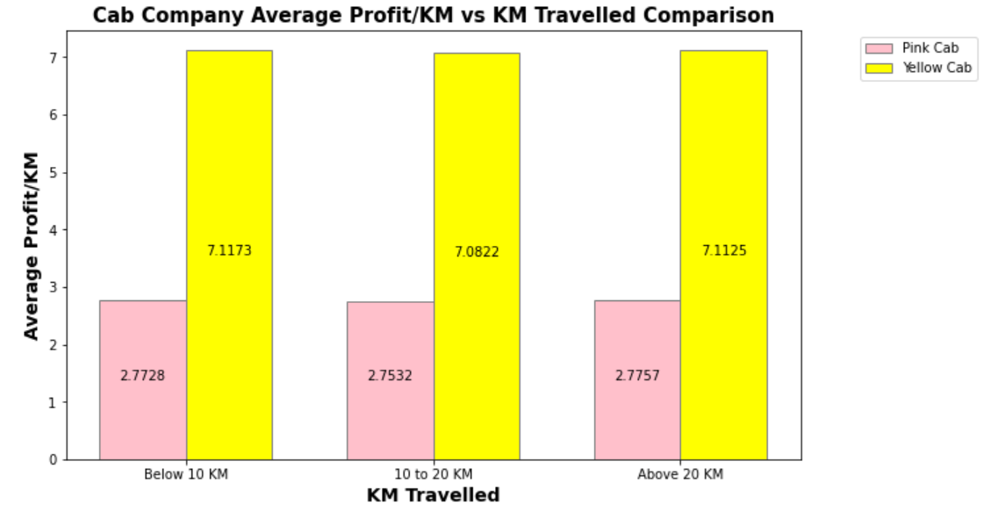
Exploratory Data Analysis
The average profit for any distance range seem to be nearly equal
Yellow cab is having more profit than Pink cab for any distance range

Slide 9
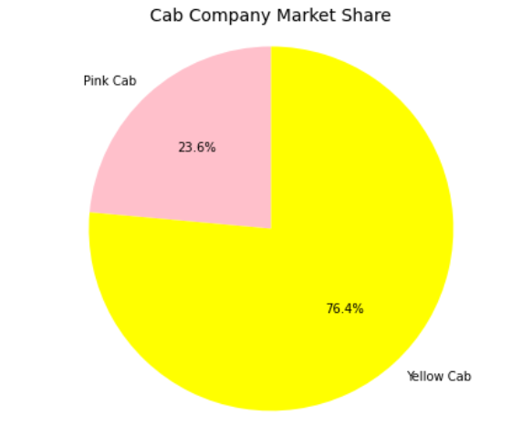
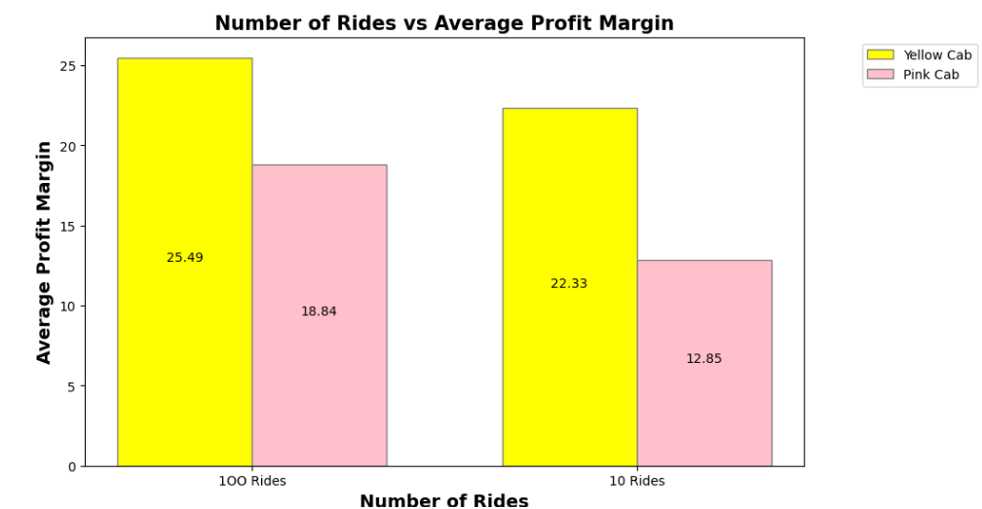
Exploratory Data Analysis
Overall, yellow cab has a greater market share than Pink Cab
For every 100 or 10 ten rides Yellow cab is making more profit than Pink cab

Slide 10
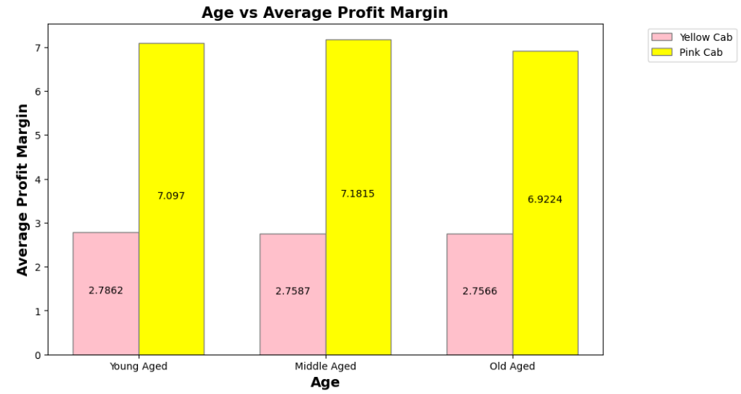
Exploratory Data Analysis
Yellow Cab is offering a slight incentive to old aged people
Pink Cab is keeping the same profit irrespective of age considerations
But the overall Profit/KM is high for Yellow cab for any age

Slide 11
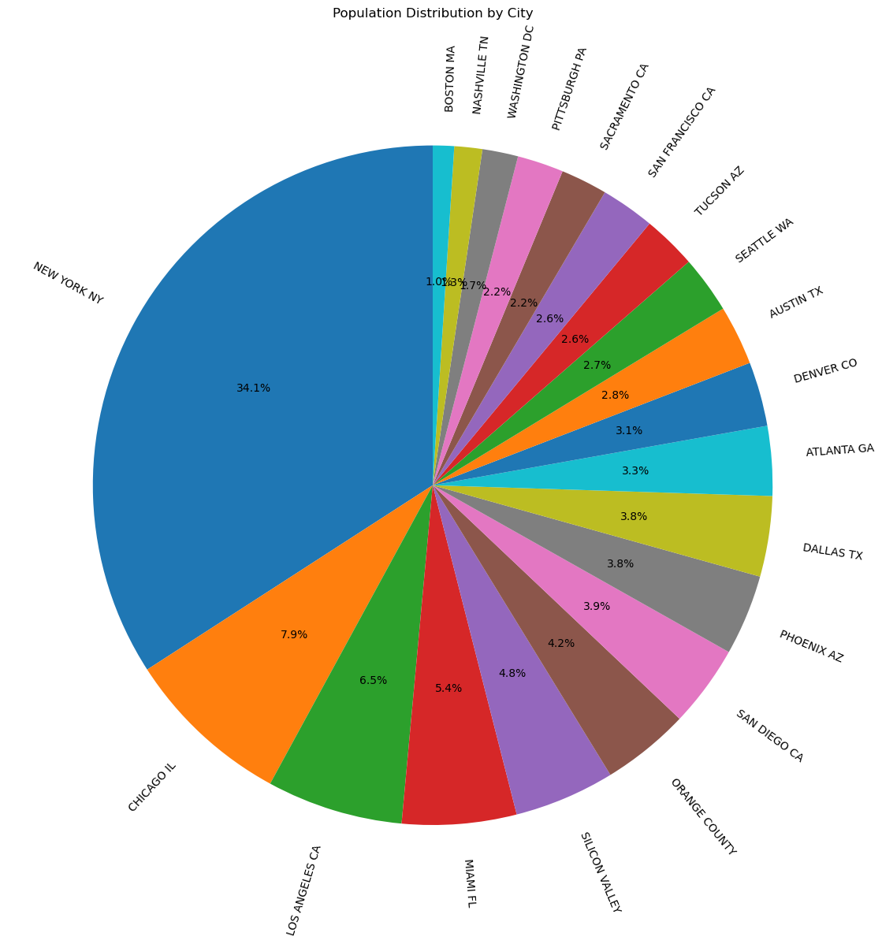
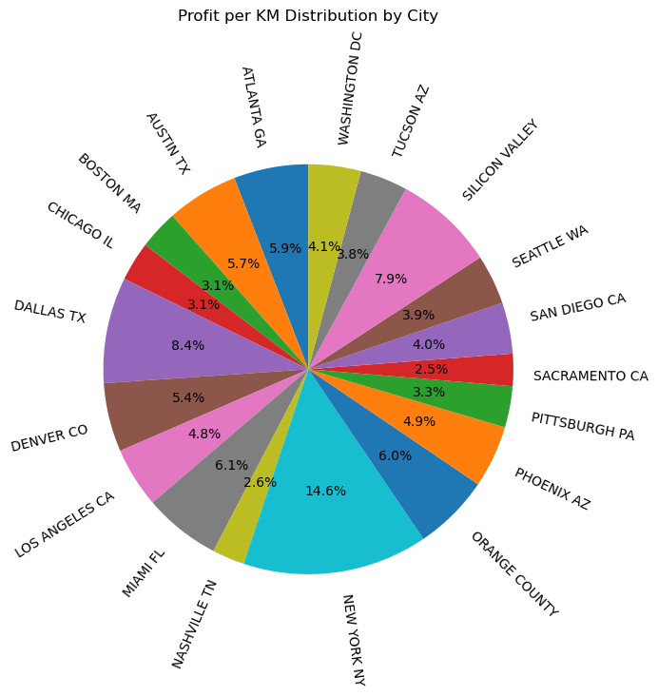
Exploratory Data Analysis

Slide 12
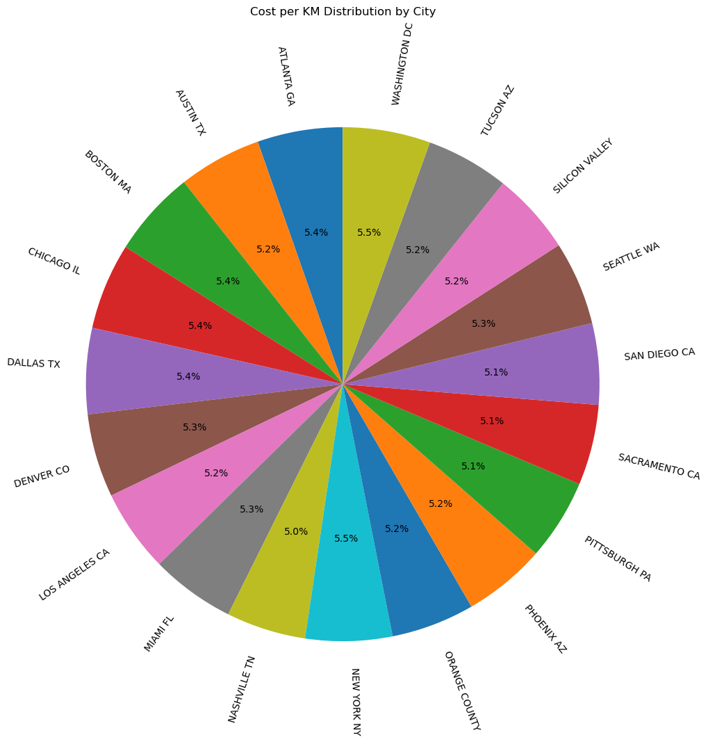
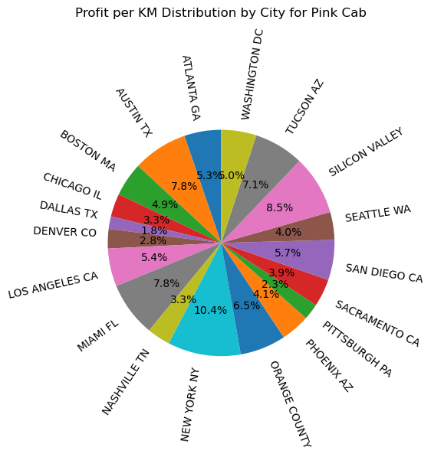
Exploratory Data Analysis

Slide 13
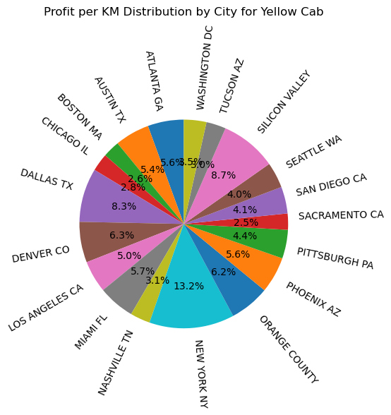
Exploratory Data Analysis
Among the cities New York is Highest populated
The Operational costs remain nearly same for all the Cities
Both Companies are making more Profit/KM from New York
EDA suggests that some cities look to spend more compared to others based on per capita income ex: Silicon Valley

Slide 14
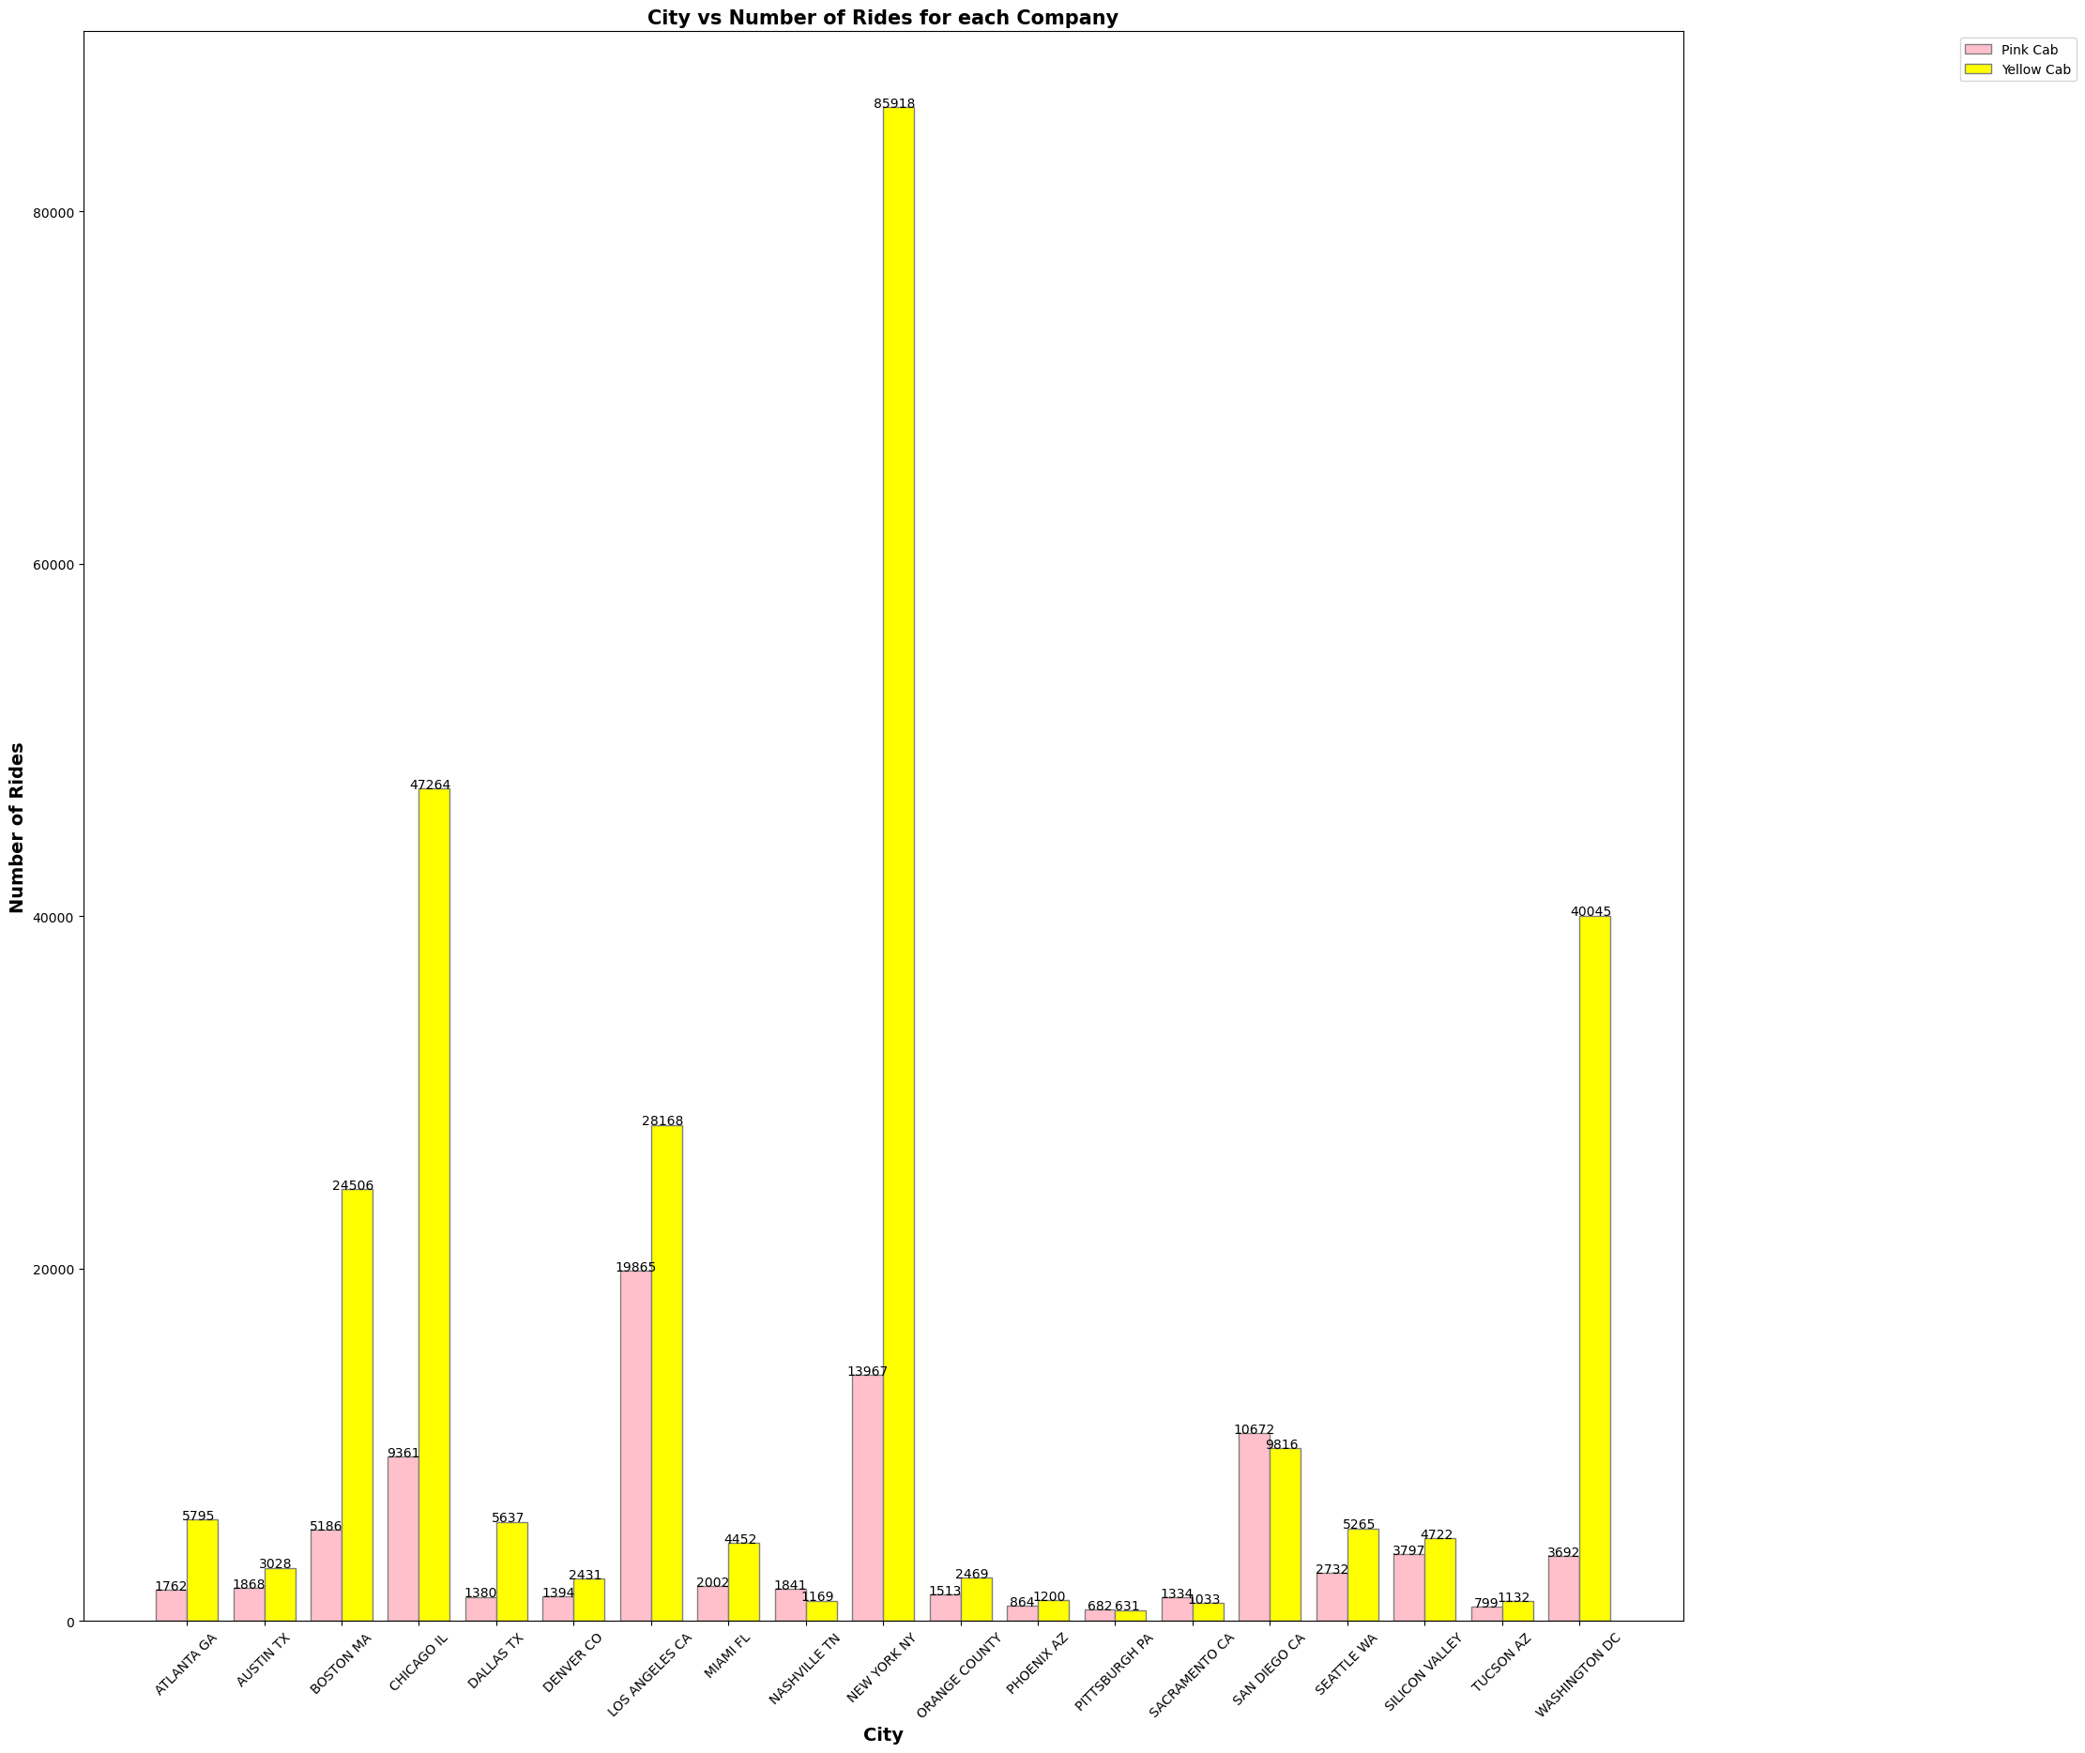
Exploratory Data Analysis
Except for San Diego, Sacramento, Nashville and Pittsburg, Yellow cab lead the ridership in all other cities
In some cities like New York and Washington DC, yellow cab is leading by a very large margin

Slide 15
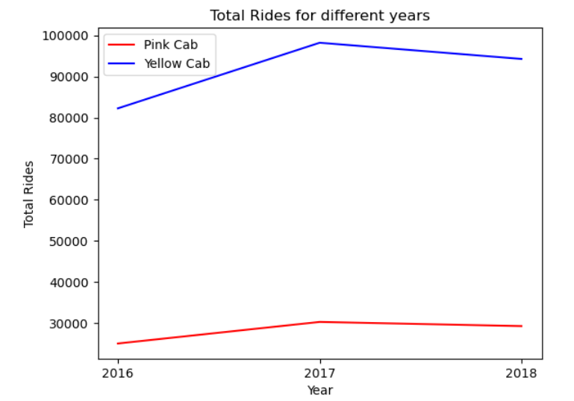
Exploratory Data Analysis
Both the companies are growing at a same rate but since The initial ridership of Yellow Cab is greater, the ridership is increased by a large margin from 2016 to 2017
Even though the rides fell from 2017 to 2018 for both companies, Yellow cab is still at a better position

Slide 16
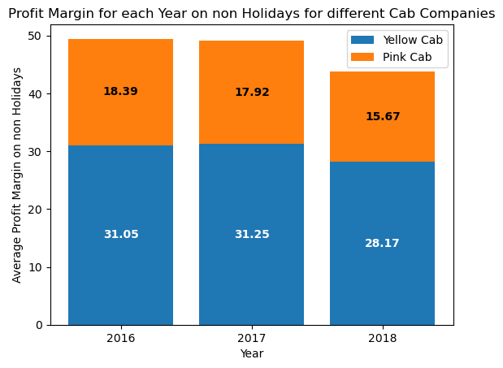
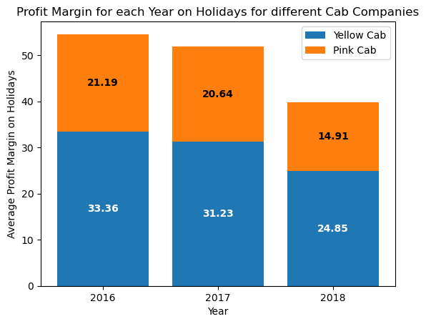
Exploratory Data Analysis
 | Rides/Day | Average Profit Margin | Average Profit/KM
Holiday | 343.31 | 27.81 | 6.22
Non Holiday | 327.43 | 27.09 | 6.08

Slide 17
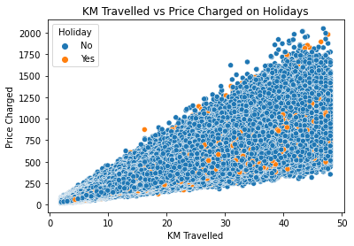
Exploratory Data Analysis
The number of rides/Day, Profit Margin and Profit/KM is slightly greater on holiday compared to non holidays
Companies made more Profit Margin in 2016 holidays than any other year
There is a decline in Profit Margin on holidays in 2018 for both the companies
The profit margin made by Yellow Cab is greater than Pink cab irrespective for holidays or year
Scatterplot also suggests that there is slight difference in profit on holidays but not too much

Slide 18
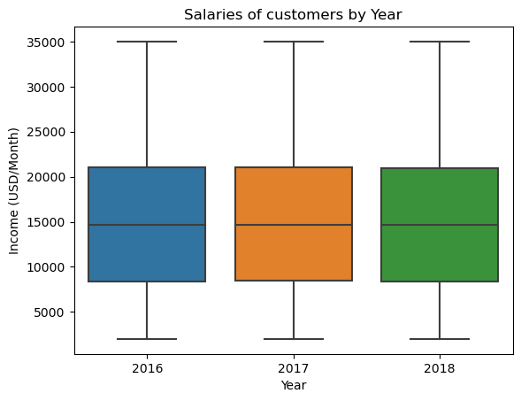
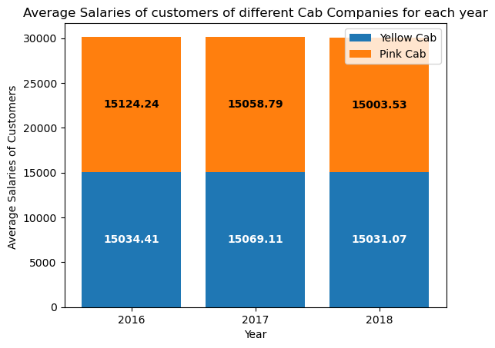
Exploratory Data Analysis
There is no difference in the salary range of customers for any year
The abnormal dip in Cab rides in 2018 seem to be act of various factors ex: inflation
The average salaries of customers for each cab companies over years seems to be nearly equal.
People with same salary are choosing yellow cab over pink even after higher prices

Slide 19
Recommendations
Profit: Yellow cab is making greater Profit/KM or Profit Margin on factors considered i.e., travel distance, number of rides, Age, Holiday and Salary
Market Share: Yellow has encapsulated greater market compared to pink cab. Even though the growth rate seem to be same, the initial greater market acquisition has helped Yellow cab more
Customer Reach: Yellow cab seem to dominate in many cities like New York, Dallas, etc., compared to pink cab. In some cities Yellow cab customers are four times compared to pink cab.
Growth: Yellow cab ha grown at 21% from 2016-2017 compared to pink cab which stands at 19%. Greater market share will likely multiply the business manifold with such growth rate
Trust: There is no discrimination of cab services taken based on the customer income. This proves the point the people are more interested in choosing Yellow Cab even after the company is charging high prices
We can Conclude from our EDA Analysis that choosing Yellow cab for investment is a wiser option

Slide 20
Thank You

